Slide 1
INTRO™

Slide 2
Outline
Mechanism
Advantages
Benefits

Slide 3
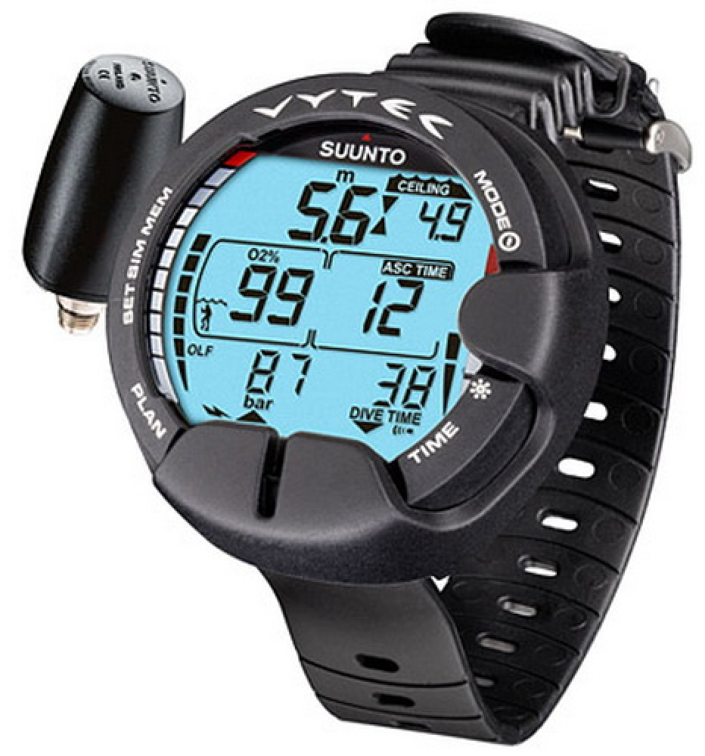

Mechanism

Slide 4
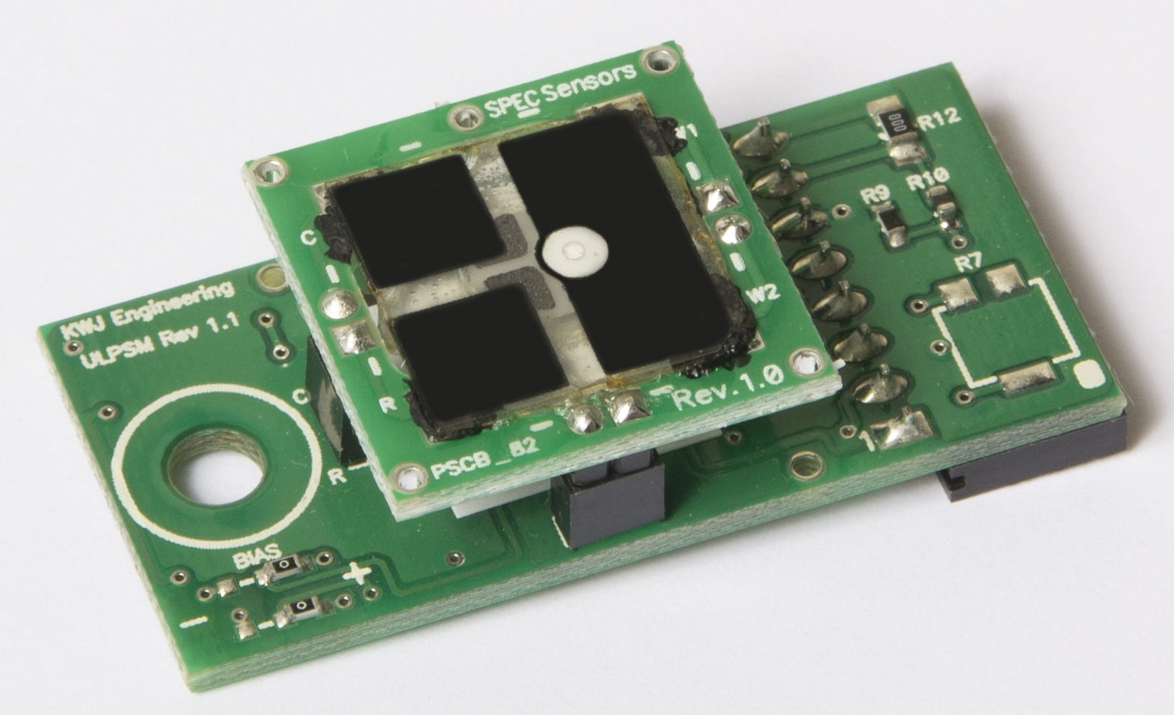
Breathing Regulator

Slide 5
Algorithm
Volume of gas of inhaling concentration of the nitrogen of inhaling
Volume of gas of exhaling concentration of the nitrogen of exhaling
Accumulated nitrogen

Slide 6
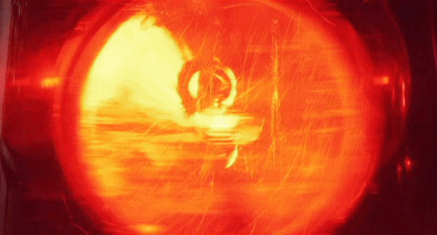
Diving Computer
Body weight, Age, Gender
Nitrogen Limit

Slide 7
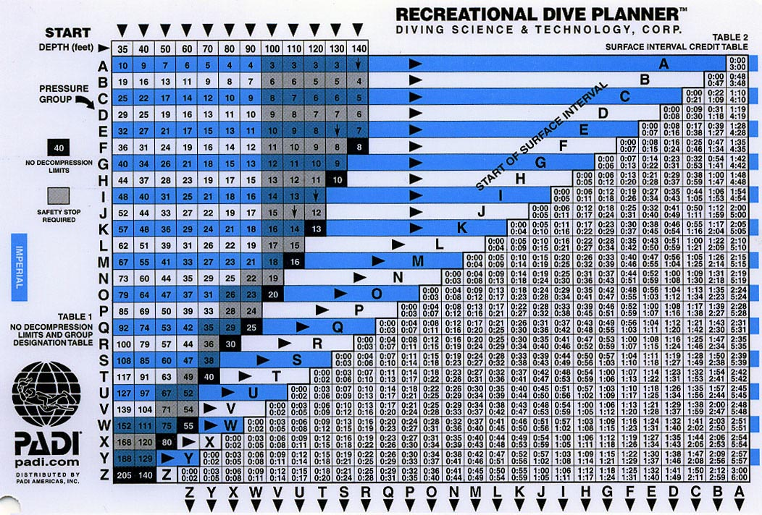

Advantages
Individual-Specific
Real-time Analysis

Slide 8


Slide 9
Safety

